Slide 1


Introduction to Computer Security
CS471
Lecture 10 Data Encryption Standard (DES) Algorithm
By:
Dr. Hussien M. Sharaf

Slide 2
History
At 1973–1974; IBM proposed DES based Feistel cipher.
DES was approved as a federal standard in November 1976.
On 26 May 2002, Advanced Encryption Standard (AES) replaced DES.

Slide 3
Criticism
DES use fixed S-boxes that are chosen in a mysterious way with no proven reasons.
S-boxes could hid very dangerous secrete gates for cryptanalysis!!

Slide 4
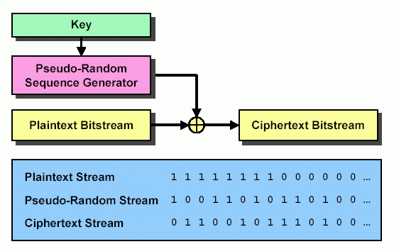
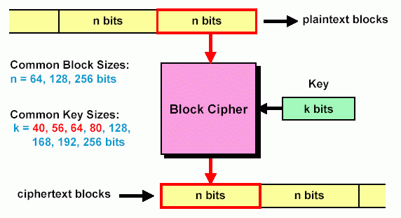
Stream Cipher Vs Block Cipher
 | Stream Cipher | Block Cipher
Definition | An encryption/decryption scheme in which a digital data stream is encrypted/decrypted one bit or one byte at a time. | An encryption/decryption scheme in which a block of plaintext is treated as a whole and used to produce a ciphertext block of equal length.
Example | Caeser and Vernam (XOR) | DES
Key | The two users share a symmetric key. | The two users share a symmetric key.
Stream Cipher example:
Block Cipher example:

Slide 5
Data Encryption Standard
It is the most widely used block cipher.
It is based on the Feistel cipher structure with 16 rounds of processing.
It takes the following inputs:
DES encryption:
Key (k) of 56 bits length.
Plaintext (p) of 64 bits length.
DES decryption:
Key (-k) of 56 bits length.
Ciphertext (c) of 64 bits length.

Slide 6
Feistel cipher structure
Input: a data block (p) and a key (k)
Partition the data block into two halves L and R.
Go through a number of rounds.
In each round,
R does not change.
L goes through an operation that depends on R and a round key derived from the key.

Slide 7
Feistel Cipher Round
Plaintext
L_{i-1} R_{i-1}
f
k_{i}
+
L_{i} R_{i}

Slide 8
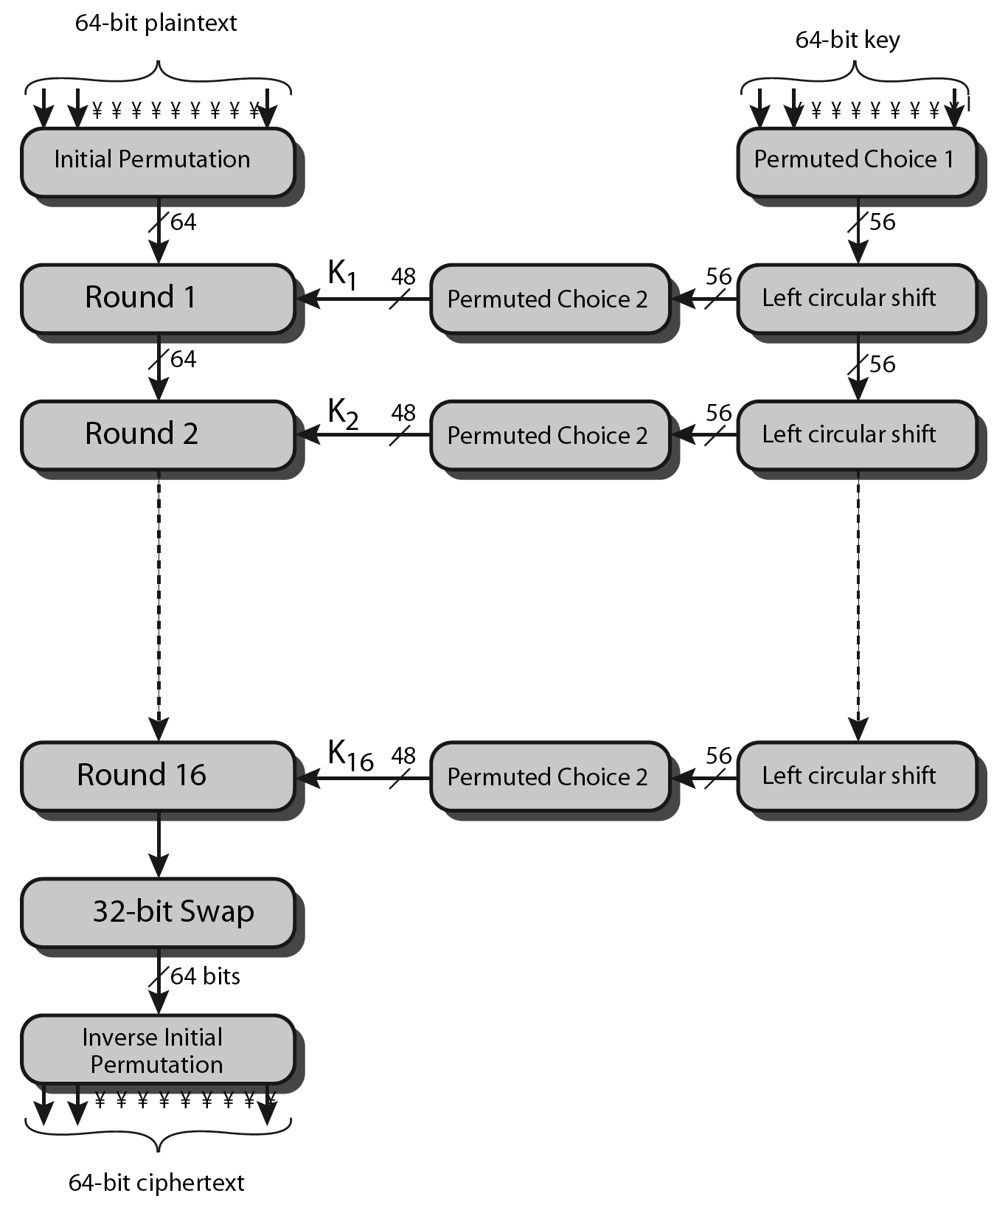
General description of DES Encryption Algorithm

Slide 9
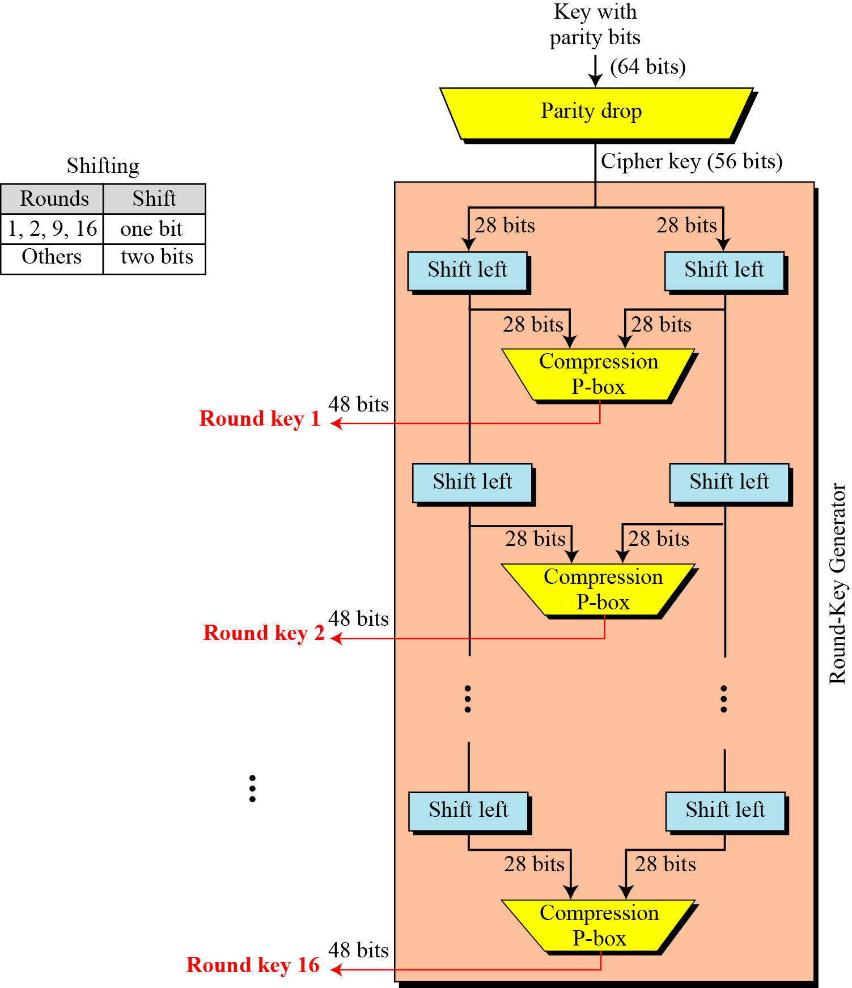
Key generation

Slide 10
DES Algorithm
Key:
Create 16 subkeys, each of which is 48-bits long.
Plaintext:
Initial Permutation (IP): 64-bit input is permuted.
16 Rounds:16 stages of identical operation differ in the 48-bit key extracted from 56-bit key.
One round computed like that:
R1 = L0 + f(R0,K1)
L1 = R0
Final inverse permutation (FP).

Slide 11
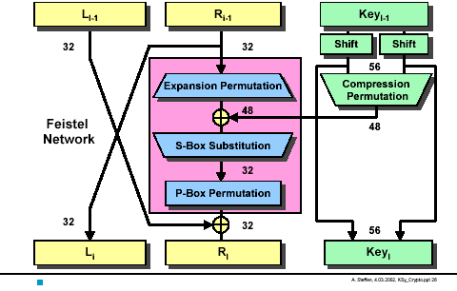
DES Round

Slide 12
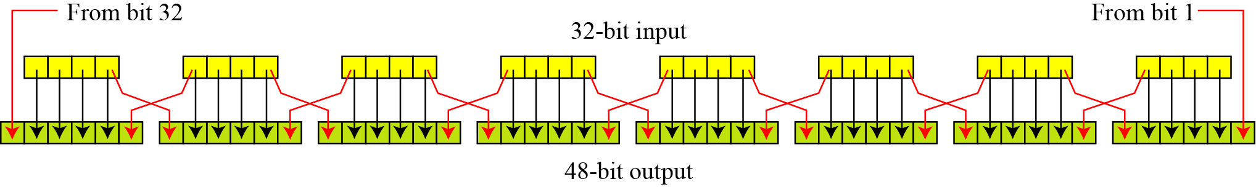
Expansion Permutation
First step of the data computation
IP Permutes and expands the input data bits.

Slide 13
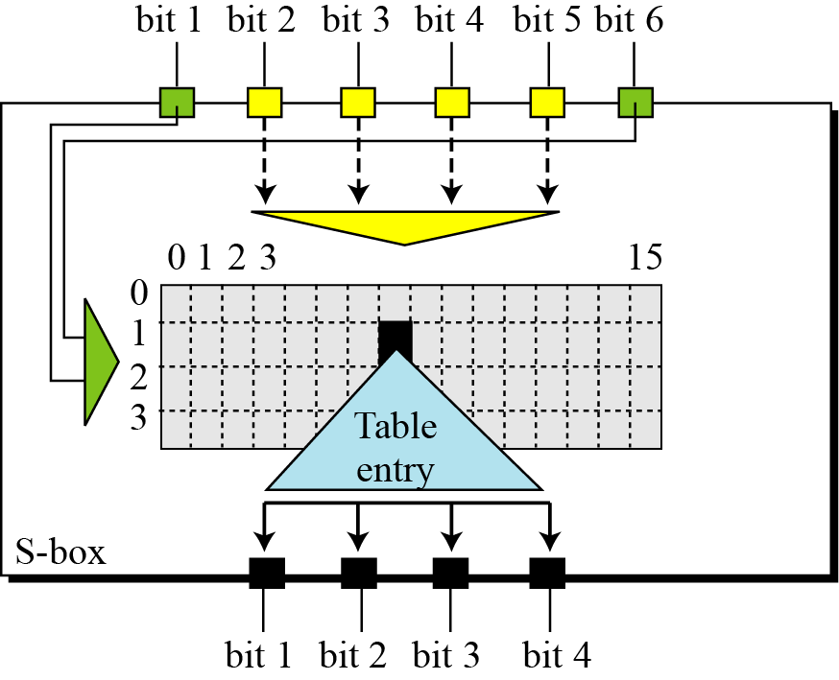
Substitution(S) Boxes
An S-Box takes 6 input bits, and transforms them into 4 output bits.
Transformation is done by substitution.
We have 8 S-Boxes.
Input is: 8blocks*6bits =48 Bits
Output is: 8blocks*4bits=32 Bits

Slide 14
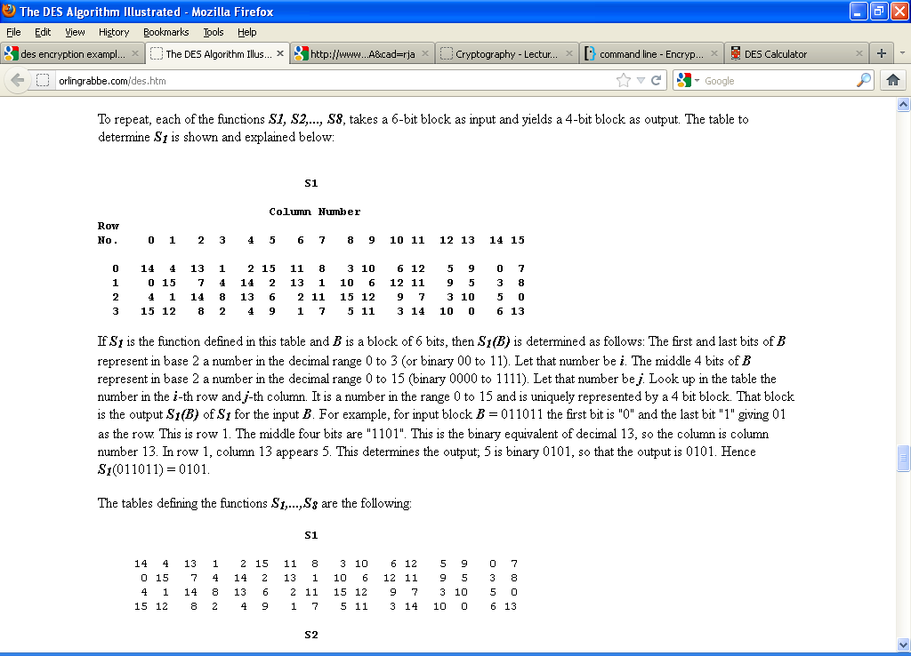
S-Boxes Example1
Assume B a block of 6 bits, then S₁(B) is determined as follows: The first and last bits of B represent in base 2 a number in the decimal range 0 to 3 (or binary 00 to 11). Let that number be i. The middle 4 bits of B represent in base 2 a number in the decimal range 0 to 15 (binary 0000 to 1111). Let that number be j. Look up in the table the number in the i-th row and j-th column. It is a number in the range 0 to 15 and is uniquely represented by a 4 bit block. That block is the output S₁(B) of S₁ for the input B.
For example, for input block B = 011011 the first bit is "0" and the last bit "1" giving 01 as the row. This is row 1. The middle four bits are "1101". This is the binary equivalent of decimal 13, so the column is column number 13. In row 1, column 13 appears 5. This determines the output; 5 is binary 0101, so that the output is 0101. Hence S₁(011011) = 0101.

Slide 15
S-Boxes Example 2
The input to S-box 1 is 100011. What is the output?
Solution
If we write the first and the sixth bits together, we get 11 in binary, which is 3 in decimal. The remaining bits are 0001 in binary, which is 1 in decimal. We look for the value in row 3, column 1, in Table 6.3 (S-box 1). The result is 12 in decimal, which in binary is 1100. So the input 100011 yields the output 1100.

Slide 16
DES Example
Key: 5B5A57676A56676E Plaintext: 675A69675E5A6B5A
Encrypting the plaintext with the key should give the ciphertext, decrypting the ciphertext with the key should give the plaintext.
The Trace produced looks like:
IP: L0=ffb2194d, R0=004df6fb
Rnd1: f(R0=004df6fb, SK1=38 09 1b 26 2f 3a 27 0f ) = 746fc91a
Rnd2: f(R1=8bddd057, SK2=28 09 19 32 1d 32 1f 2f ) = 7add38ae
Rnd3: f(R2=7a90ce55, SK3=39 05 29 32 3f 2b 27 0b ) = a5e3f499
Rnd4: f(R3=2e3e24ce, SK4=29 2f 0d 10 19 2f 1d 3f ) = c5403e1c
Rnd5: f(R4=bfd0f049, SK5=03 25 1d 13 1f 3b 37 2a ) = 91a62c82
Rnd6: f(R5=bf98084c, SK6=1b 35 05 19 3b 0d 35 3b ) = 6aeb6bc3
Rnd7: f(R6=d53b9b8a, SK7=03 3c 07 09 13 3f 39 3e ) = 1e9f7513
Rnd8: f(R7=a1077d5f, SK8=06 34 26 1b 3f 1d 37 38 ) = 59d1851c
Rnd9: f(R8=8cea1e96, SK9=07 34 2a 09 37 3f 38 3c ) = 0fc4b474
Rnd10: f(R9=aec3c92b, SK10=06 33 26 0c 3e 15 3f 38 ) = 8de55e67
Rnd11: f(R10=010f40f1, SK11=06 02 33 0d 26 1f 28 3f ) = dced7991
Rnd12: f(R11=722eb0ba, SK12=14 16 30 2c 3d 37 3a 34 ) = 898d0def
Rnd13: f(R12=88824d1e, SK13=30 0a 36 24 2e 12 2f 3f ) = 34cee3c3
Rnd14: f(R13=46e05379, SK14=34 0a 38 27 2d 3f 2a 17 ) = 6a4754b1
Rnd15: f(R14=e2c519af, SK15=38 1b 18 22 1d 32 1f 37 ) = 5bac9dc6
Rnd16: f(R15=1d4ccebf, SK16=38 0b 08 2e 3d 2f 0e 17 ) = e448c462
FP: L=974affbf, R=86022d1f
Ciphertext: 974affbf86022d1f

Slide 17
Thank you

